Slide 1
201813151_김민겸
Introduce My Favorite Game

Slide 2

First Person Shooting Game

Slide 3
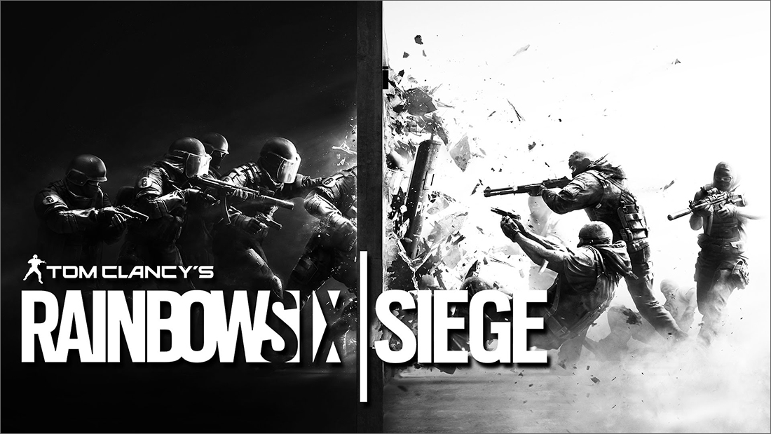
Tom Clancy’s Rainbow Six Siege

Slide 4
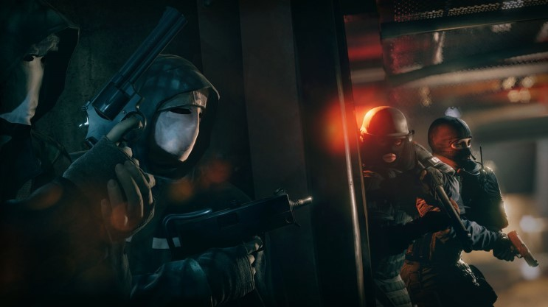
Tactics CQB FPS

Slide 5
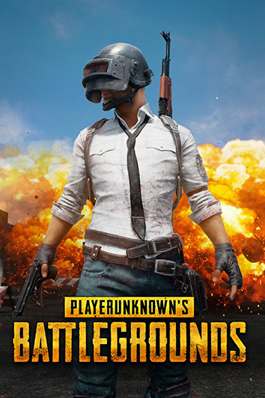
Fight distance
200~500m
5~50m

Slide 6
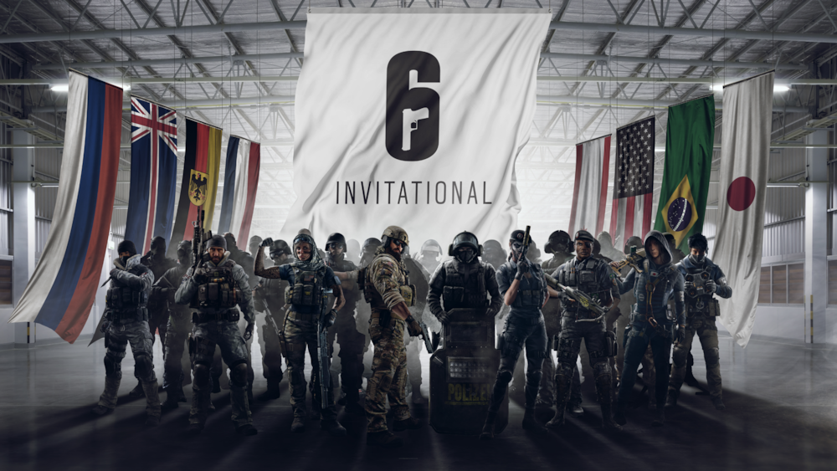
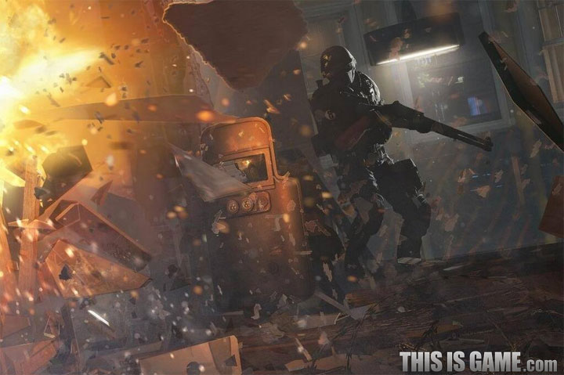
Main Game System
Operator
Breaching

Slide 7
Operator

Slide 8
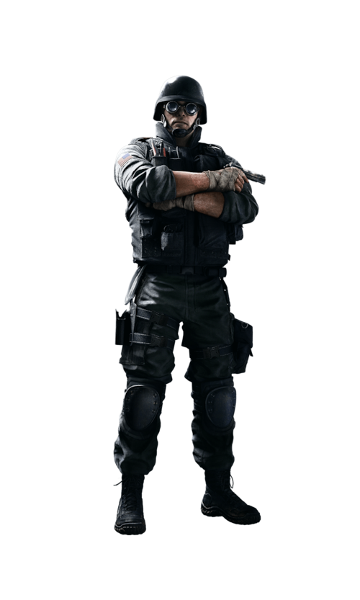

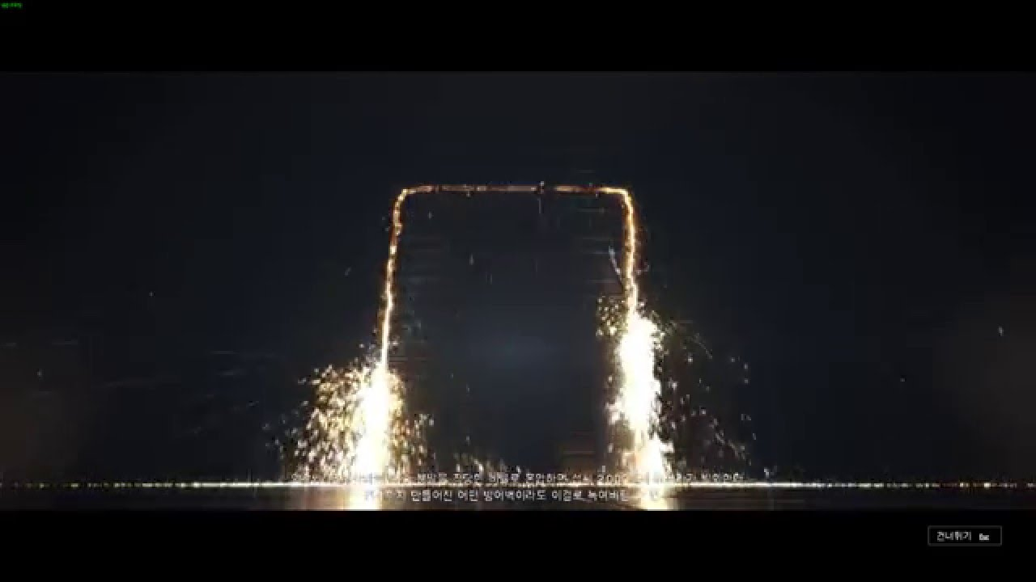
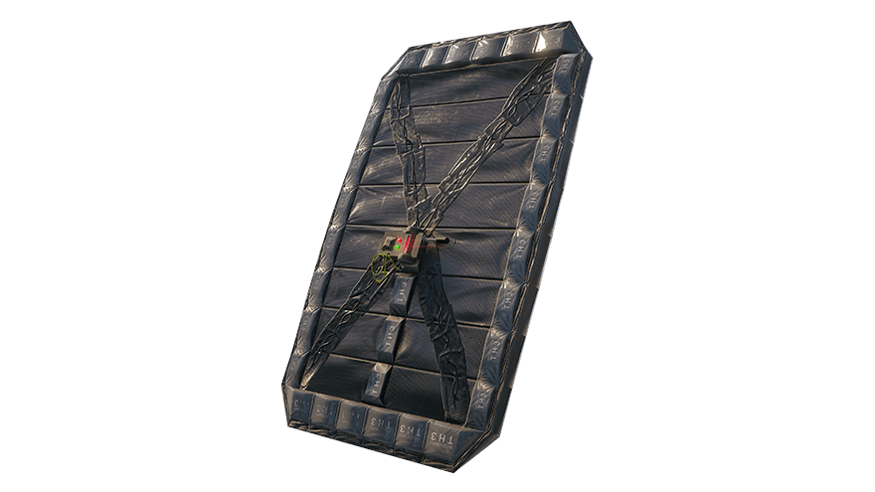
Operator
THERMITE
Where there's a wall, there's a way.

Slide 9
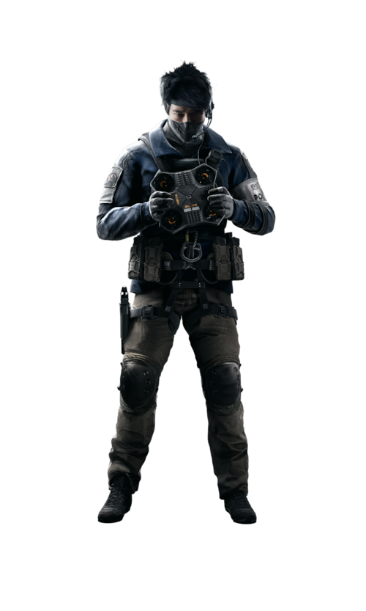

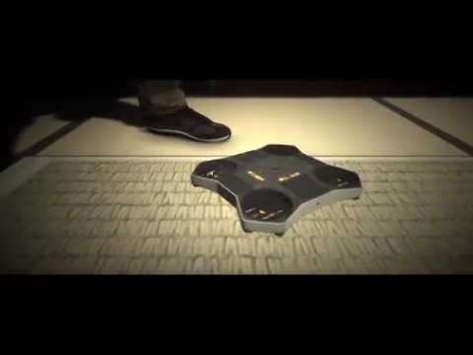
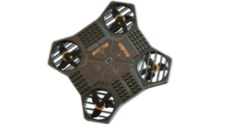
Operator
ECHO
Time to be efficient. And a little bit lazy.

Slide 10
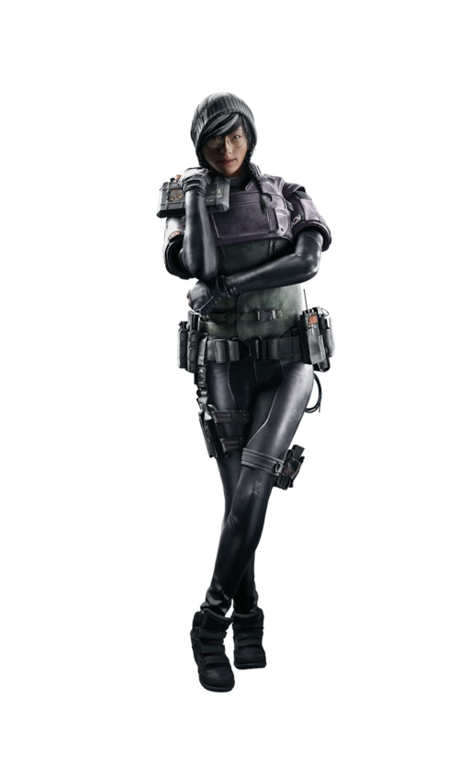

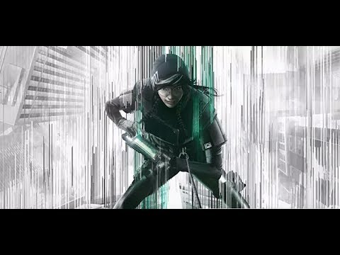

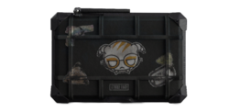
Operator
DOKKAEBI
Let's see what they're up to.

Slide 11
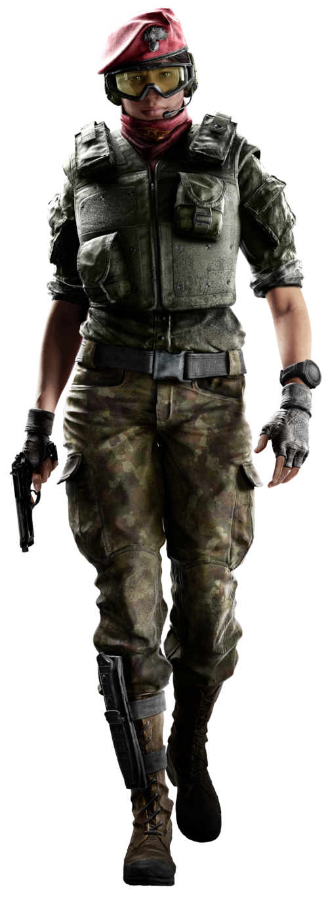

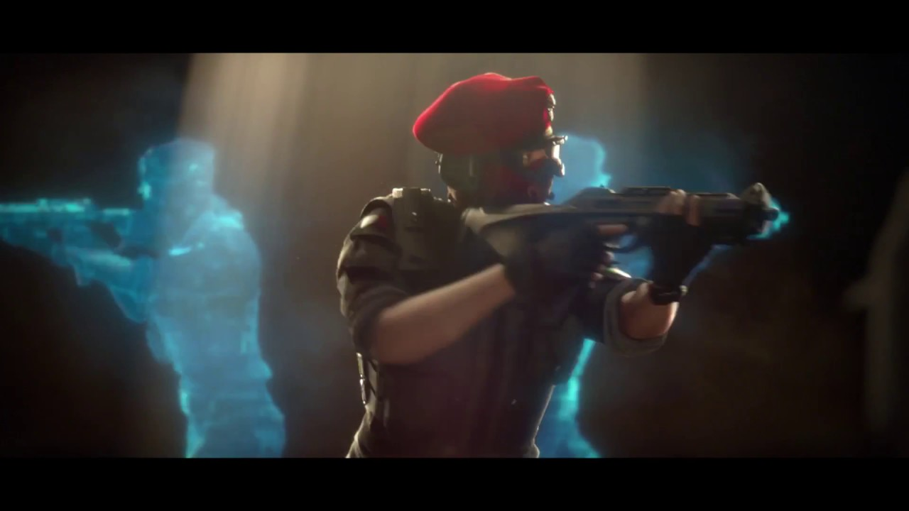
Operator
ALIBAI
Illusion are fatal.

Slide 12
Breaching

Slide 13
And Fin…

